Slide 1

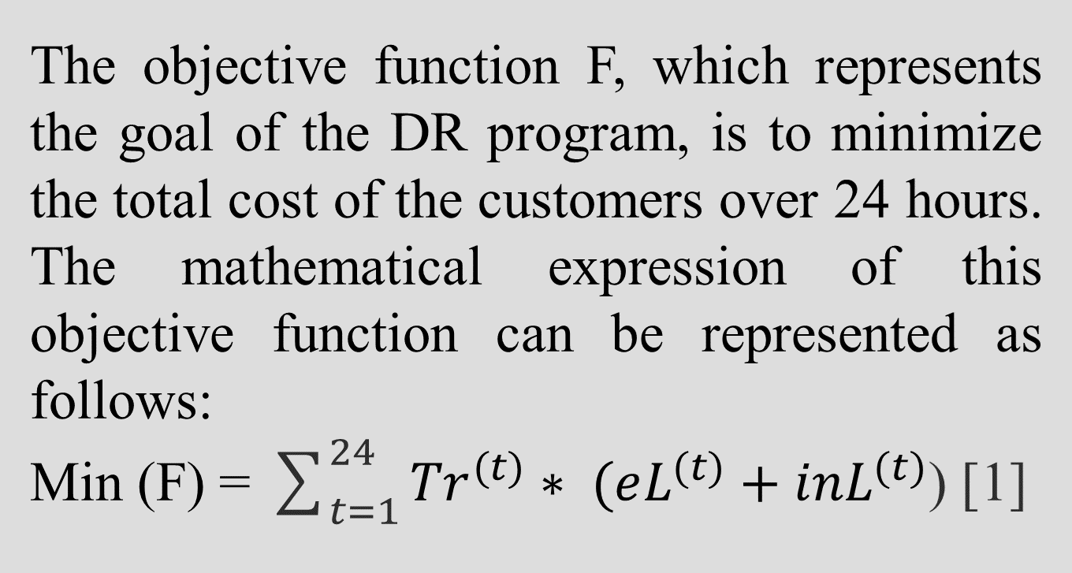
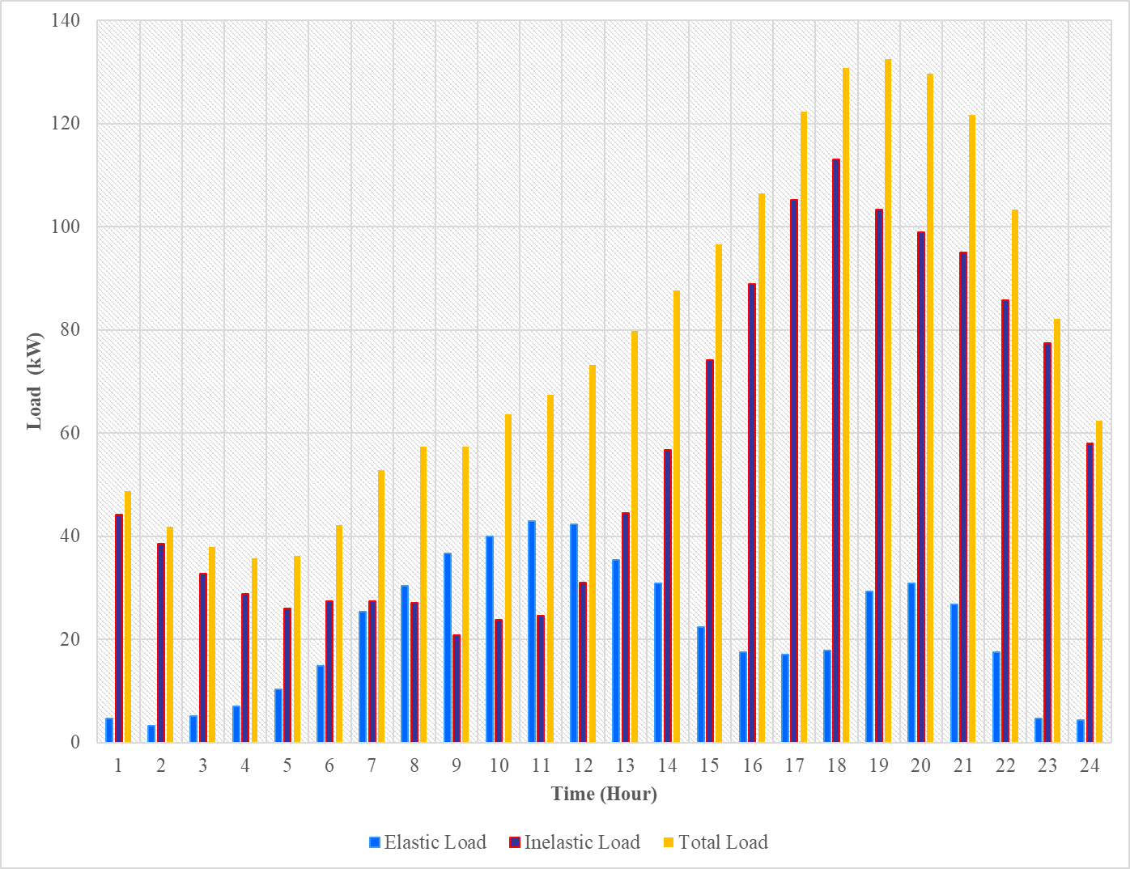
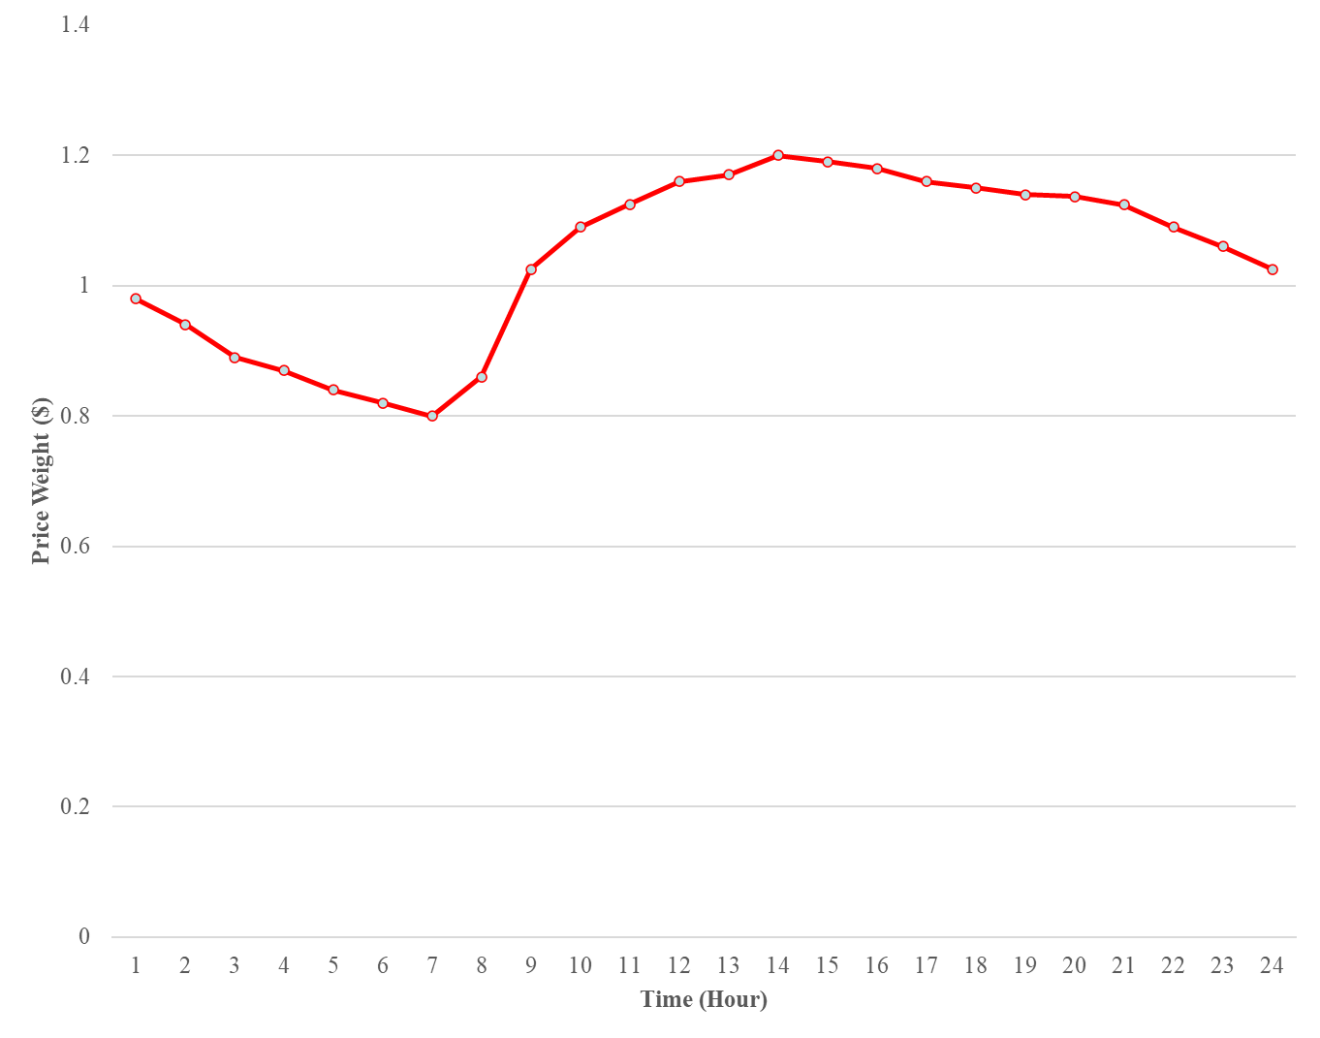
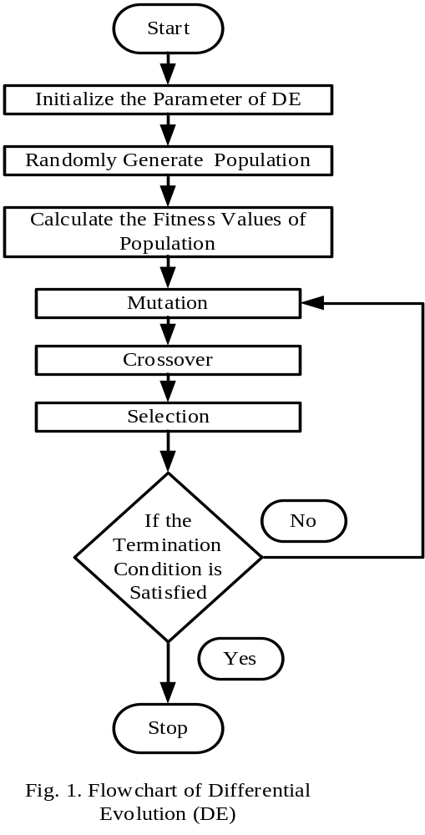
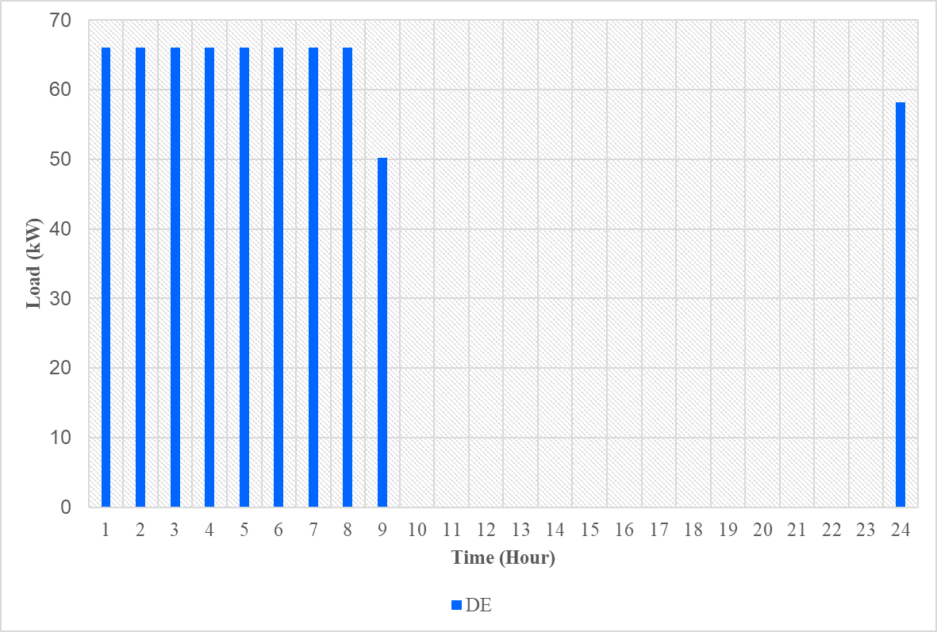
“Optimal Operational Scheduling of a Grid-Connected Power
System Based on Demand Response”
ANTU ROY (M230635EE), Master of Technology (Power Electronics), Department of Electrical Engineering
National Institute of Technology Calicut, Kozhikode, Kerala
ABSTRACT
INTRODUCTION
OBJECTIVE OF WORK
PROBLEM FORMULATION
CONCLUSION
Demand Response (DR) is indeed considered one of the best possible solutions to reduce peak demand and energy consumption in modern power systems. In this work, the operation strategy of a power system network based on demand response has been proposed to operate the network at high efficiency and in an economical manner. Both elastic loads and inelastic loads have been considered to optimize the economic operation of the power grid. The objective is to find out the most cost-effective way of managing electricity consumption by balancing the usage of elastic loads and ensuring the continuous operation of inelastic loads while minimizing overall costs. The work mentioned above proposed the use of three soft-computing techniques, Differential Evolution (DE) to solve the problems. The simulation results of the recommended algorithm demonstrate that it effectively reduces cost while simultaneously balancing the peak demand.
The Demand Response (DR) is one of the best possible solutions to reduce peak demand and energy consumption in the modern power system.
The main purpose of DR is to reduce the peak load demand depending on the price weight given by the utility company, this will also result in the reduction of utility cost of the consumers.
Demand response is proposed to reduce the daily operating cost of the power grid without sacrificing the consumer’s comfort level and by maximizing the benefit.
When electricity demand is high, the cost of producing and delivering electricity increases, and the power grid may become overloaded.
To solve the demand response problem by considering a grid-connected power system by load shifting.
Minimization of cost of the demand side and the maximization of revenue of the supply side in a grid-connected power system network.
Load shifting can help to minimize the cost of energy consumption by shifting electricity usage to off-peak hours when electricity prices are lower. The load scheduling strategy based on DE can be employed in the future Smart Grid.
By effectively balancing energy supply and demand, a grid-connected power system can improve grid reliability, reduce energy costs, promote renewable energy integration, and enhance the customer experience.
INPUT DATA
REFERENCES
[1] Muhammad Jibran, Hasan Arshad Nasir, Qureshi, Usman Ali, “A Demand Response-Based Solution to Overloading in Underdeveloped Distribution Networks” IEEE TRANSACTIONS ON SMART GRID, VOL. 12, NO. 5, SEPTEMBER 2021.
[2] Tianhao Liua, Dongdong Zhang, Shuyao Wang, “Standardized modeling and economic optimization of multi-carrier energy systems considering energy storage and demand response” ENERGY CONVERSION AND MANAGEMENT 182 (2019) 126–142.
[3] Wei-Yu Chiu, Member, Jui-Ting Hsie, and Chia-Ming Chen “Pareto Optimal Demand Response Based on Energy Costs and Load Factor in Smart Grid” IEEE TRANSACTIONS ON INDUSTRIAL INFORMATICS, VOL. 16, NO. 3, MARCH 2020.
SOLUTION METHODOLOGY
Fig. 2. Daily average 24-hour load profile.
Fig.3. Hourly price weight
Fig. 2. Daily average 24-hour load profile [2, 3]
Fig. 3. Hourly price weight [2, 3]
RESULT
Optimization Technique | Number of Runs | No. of Hits to Best Solution | Minimum Cost ($) | Maximum Cost ($) | Average Cost ($) | Standard Deviation
DE | 10 | 10 | 2221.13 | 2221.13 | 2221.13 | 0.0299
CONTACT
ANTU ROY
National Institute of Technology Calicut
Email: antu_m230635ee@nitc.ac.in
Phone: 8116375765
Table 1 Cost of energy consumed by the consumers
Fig. 4. Hourly scheduled load values with DE
Fig. 1. Flow chart of DE

